Slide 1
Hub-and-Spoke
Virtual Network Topology
HUB VNet
Shared services
Three departments. One shared hub. Secure, scalable isolation.
TEAM
• 2400089009
• 2400089007
• 2400080269
• 2400080297
Dept A
Dept B
Dept C
Spoke
Spoke
Spoke
Centralized control • Isolated workloads • Predictable connectivity
01

Slide 2
01 • THE CHALLENGE
Why a hub-and-spoke design?
A common network foundation for multiple departments without creating a flat, hard-to-manage network.
Centralize shared services
Isolate departments
Scale independently
Put firewall, VPN/ExpressRoute gateway, DNS and monitoring in one controlled hub.
Each department gets its own spoke VNet, address space, subnets and workload boundary.
Add new departments or workloads without redesigning the entire network.
Design principle
Shared services live in the hub; business workloads live in the spokes.
HUB
Shared services
→
PEERING
Private connectivity
→
SPOKES
Department workloads
02

Slide 3
02 • ARCHITECTURE
Three spokes, one shared hub
The topology separates ownership and workloads while keeping common infrastructure in one place.
HUB VNET
Azure Firewall
VPN / ER Gateway
Traffic inspection
Hybrid connectivity
DNS + Monitor
VNet Peering
DEPT A
DEPT B
DEPT C
Finance / HR
Engineering
Operations
Workloads • Subnets • NSGs
Workloads • Subnets • NSGs
Workloads • Subnets • NSGs
Non-transitive peering: A ↔ Hub ↔ B does not automatically mean A ↔ B.
03

Slide 4
03 • CONNECTIVITY
How traffic flows through the design
Peering provides private connectivity; routing and security controls determine which paths are actually allowed.
Spoke → Hub
Spoke → Internet
Spoke → Spoke
Department workload reaches shared services through VNet peering. NSGs and firewall rules control access.
Outbound traffic can be inspected and controlled through centralized security architecture.
Not transitive by default. Use direct peerings or a routing/NVA design when cross-department communication is required.
Request
Route
Inspect
Allow / Deny
Destination
App / VM
UDR / system route
Firewall / NVA
NSG + policy
Service / VNet
04

Slide 5
04 • BOTTLENECKS
What students commonly get wrong
Two issues can break the design before the first VM is even deployed.
01 Non-transitive peering
02 Overlapping address spaces
Peering is point-to-point. If Dept A peers with the Hub and Dept B peers with the Hub, that does not automatically create a route from A to B.
A VNet and its peer need non-overlapping address spaces. Duplicate CIDRs create ambiguous routing and prevent peering.
SYMPTOM
A → Hub works | Hub → B works | A → B fails
SYMPTOM
Example: 10.0.0.0/16 used by two VNets
Design checks before deployment
1
Plan CIDRs first
2
Create hub ↔ spoke peerings
3
Define required cross-spoke paths
4
Test routes + security rules
05

Slide 6
05 • IMPLEMENTATION
Build it in Azure: a practical sequence
A repeatable workflow reduces configuration errors and makes the topology easy to demonstrate.
01
Plan
02
Create
03
Peer
CIDRs, subnets, ownership
Hub + 3 spoke VNets
Hub ↔ each spoke
04
Secure
05
Route
06
Validate
NSGs + firewall policy
UDRs / gateway paths if needed
Connectivity + failure tests
Demo proof: show successful Hub/Spoke connectivity, then intentionally demonstrate a blocked or non-transitive path.
06

Slide 7
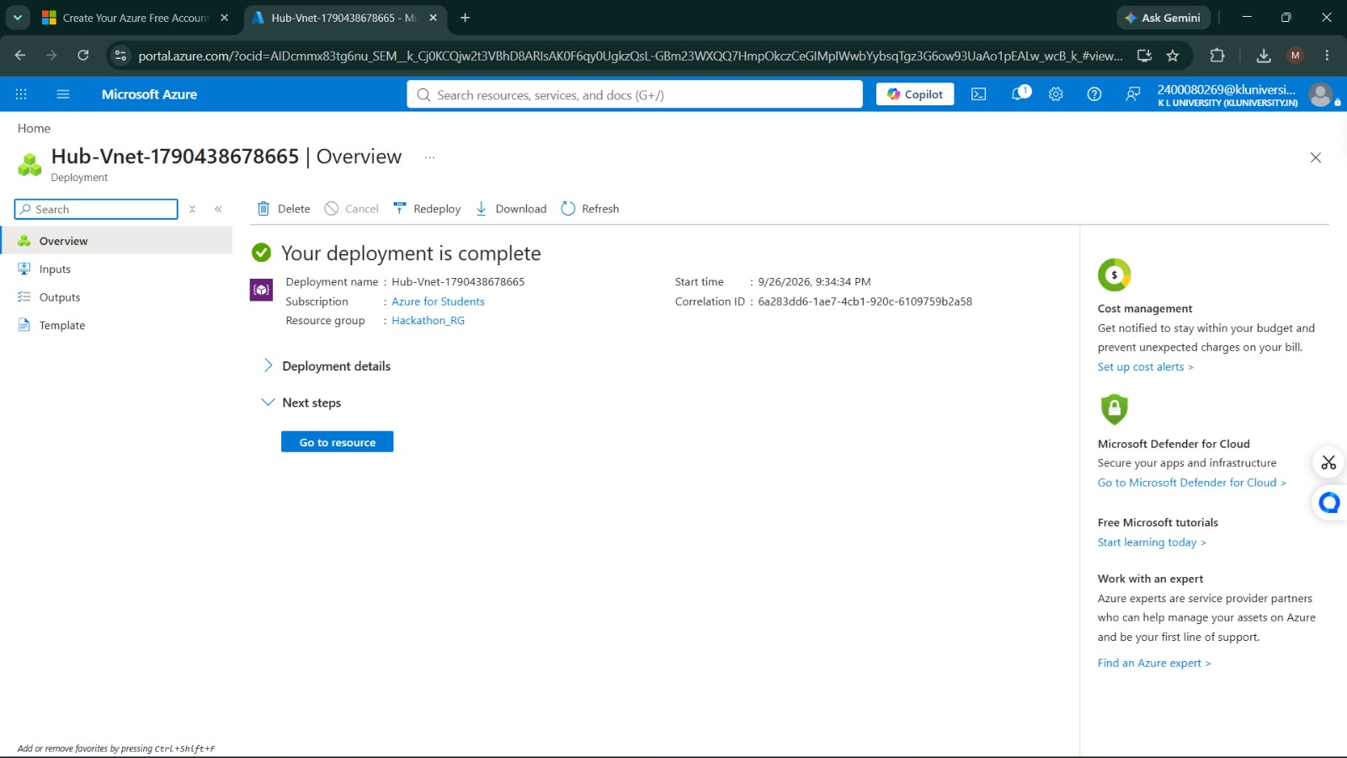

06 • PROOF
Proof it’s built: the hub and first spoke
Live Azure portal screenshots confirming the hub VNet and Spoke_T001 deployed successfully.
Hub-Vnet deployed successfully
Spoke_T001 deployed successfully
07

Slide 8


06 • PROOF
Proof it’s built: the remaining spokes
Live Azure portal screenshots confirming Spoke-T103 and Spoke-T205 deployed successfully.
Spoke-T103 deployed successfully
Spoke-T205 deployed successfully
08

Slide 9
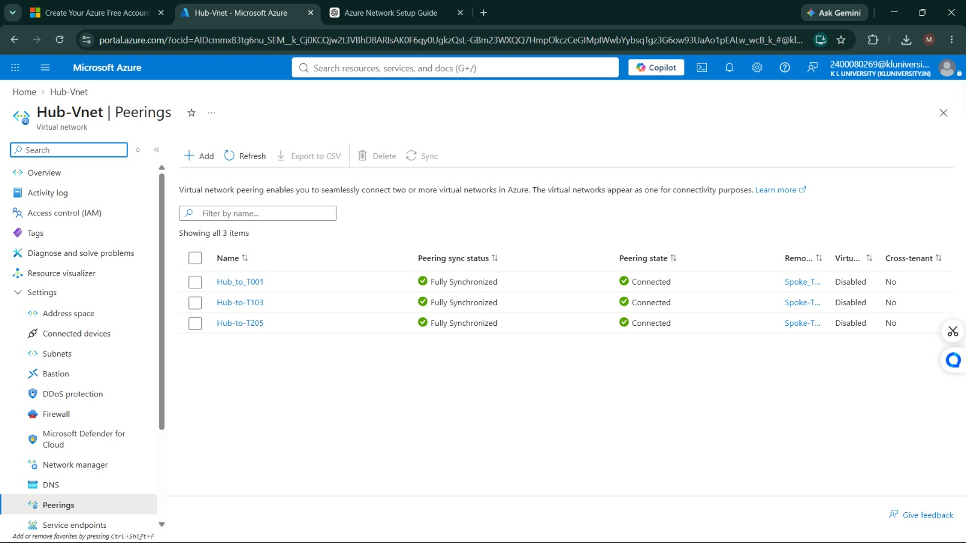
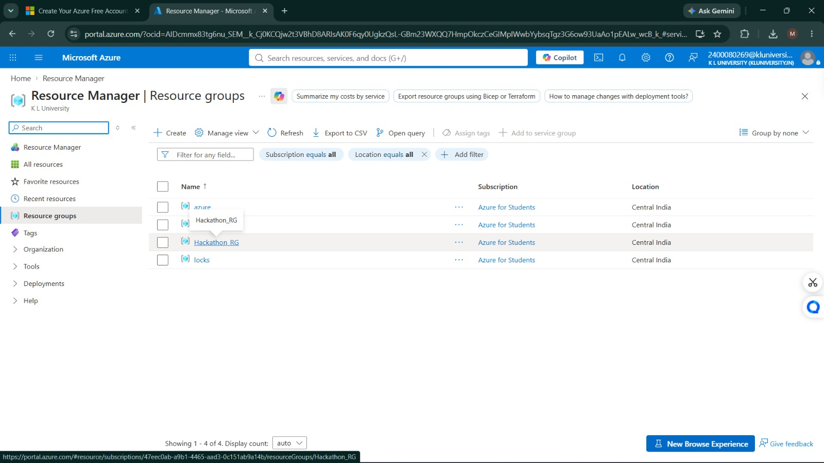
06 • PROOF
Proof it’s built: peering and resources
Live Azure portal screenshots confirming Hub ↔ Spoke peerings and the resource group.
Hub ↔ Spoke peerings fully synchronized
Hackathon_RG resource group provisioned
09

Slide 10
A network that is simple to explain —
and strong enough to scale.
Hub = shared control | Spokes = isolation | Peering = private connectivity
SECURITY
SCALABILITY
OPERABILITY
Central inspection + least-privilege access
Add departments without redesigning the core
Clear ownership and easier troubleshooting
Before the demo
✓ Non-overlapping CIDRs ✓ Hub ↔ Spoke peerings ✓ NSG rules ✓ Route validation
Thank you
10

